Slide 1


COVID-19 GLOBAL DASHBOARD
Power BI Dashboard Project
Prepared By
Benjamin Umanta Esther
Week 4- Data Visualization & Dashboarding
AnalystLab Africa Internship
July 2026

Slide 2
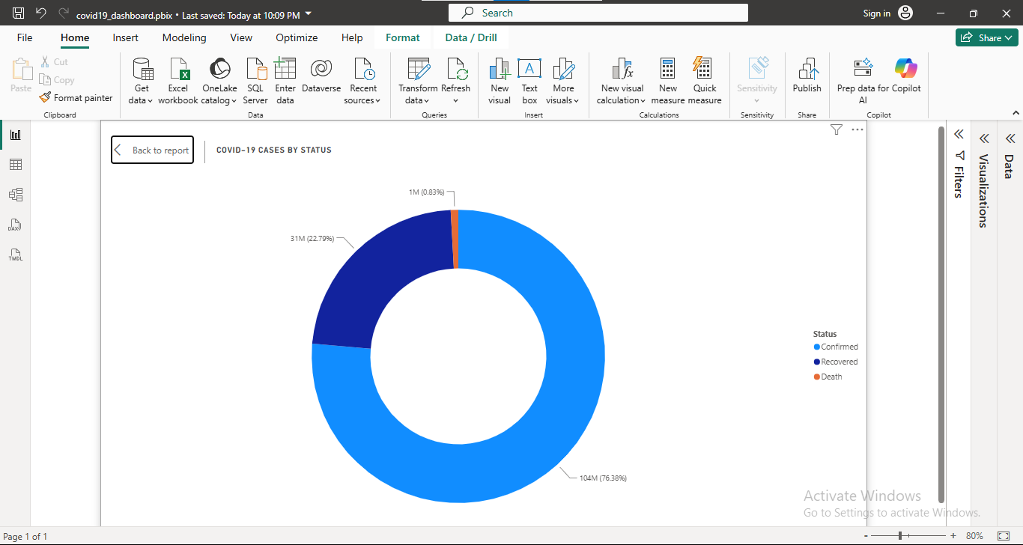
DATASET OVERVIEW
Dataset Used
COVID-19 Global Dataset
Source
John Hopkins University (CSSE)
Period Covered
January 2020-March 2023
Content
Confirmed Cases
Deaths
Recoveries
Countries/Regions
Date
Longitude & Latitude

Slide 3
PROJECT OBJECTIVE
The covid-19 pandemic affected millions of people worldwide. Government and health organizations needed reliable data to monitor the spread of the virus and make informed decision.
This dashboard was created to;
Monitor confirmed cases .
Compare the number of recoveries and death.
Analyze case trends overtime.
Identify the most affected countries.
Support date driven public health decision.

Slide 4
DASHBOARD OVERVIEW
This dashboard includes;
KPI cards showing the latest confirmed, death and recovered cases.
A World Map displaying the geographical distribution of COVID-19 cases.
A line chart showing trends over time.
A donut chart comparing case categories.
Interactive slicers for country and date.

Slide 5
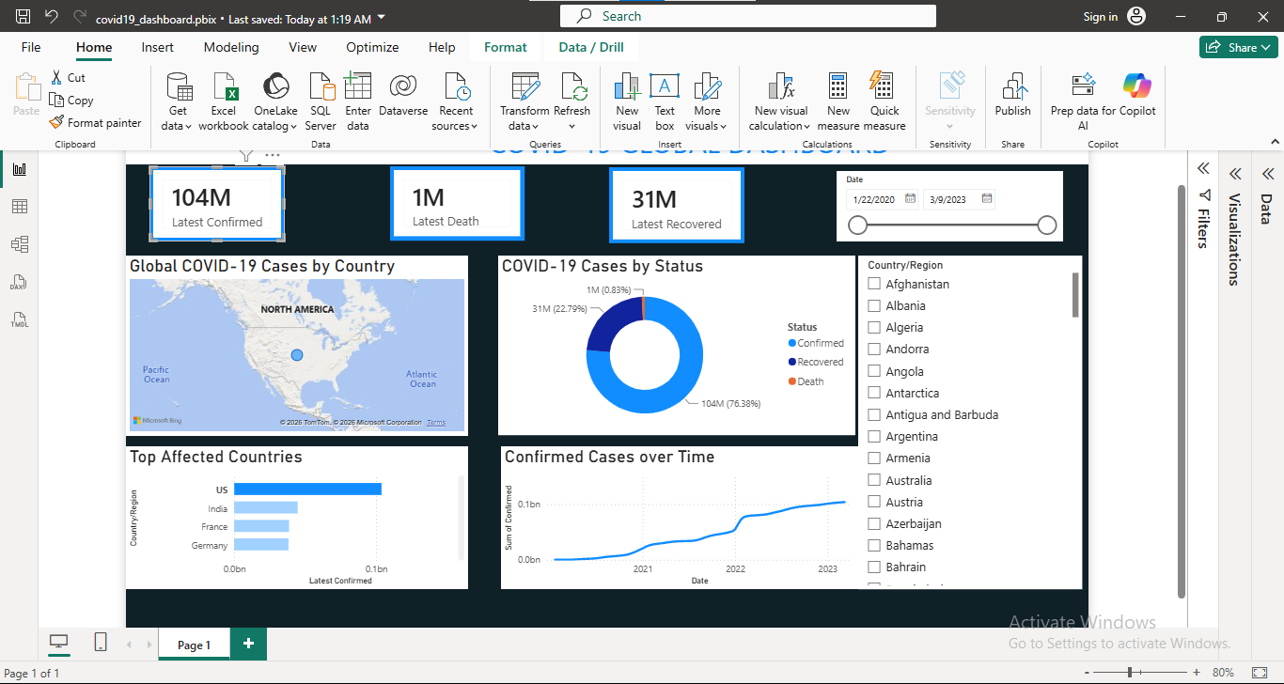
DASHBOARD

Slide 6
KEY INSIGHT
From my analysis these are the insight discovered;
The United State has the highest cases confirmed with approximately 104M confirmed cases.
India recorded the second-highest cases confirmed with approximately 45M cases confirmed.
The cases confirmed is higher then the recovery and death rate across countries with a significant difference.
The dashboard allows users to compare COVID-19 statistics by country and date.
The visualization made it easy to identify trends and compare the impact of the COVID-19 across different regions.
This project uses a real-world COVID-19 dataset published by the Johns Hopkins University Center for Systems Science and Engineering (CSSE).
The dataset contains officially reported global COVID-19 confirmed cases, deaths, and recoveries collected from public health authorities worldwide.

Slide 7
RECOMMENDATION
Health authorities should continue to strengthen disease surveillance and reporting systems to detect outbreaks early.
Countries with high numbers of confirmed cases should maintain strong public health preparedness and emergency response plans.
Governments and healthcare organizations should use interactive dashboards to monitor trends and support timely decision-making.
Public awareness campaigns should continue to promote preventive health practices during disease outbreaks.
Data should be updated regularly to ensure that policymakers and researchers make decisions based on the most current information.
Regular data updates are also important for tracking trends and responding effectively to future public health challenges.

Slide 8
CHALLENGES ENCOUNTERED
During the development of this dashboard, I encountered several challenges, including:
Recovering the Confirmed column after it was accidentally removed in Power Query.
Resolving DAX measure errors that affected the KPI cards.
Fixing the map visual when it temporarily stopped displaying.
Arranging the dashboard layout to fit properly on a single page.
Adjusting font sizes and visual formatting to improve readability.
Learning to use slicers effectively for interactive filtering by country and date.

Slide 9
CONCLUSION
In conclusion, this project demonstrates the value of data visualization in understanding global health trends.
Using Power BI, I transformed a real-world COVID-19 dataset into an interactive dashboard that makes complex data easier to understand and analyze. Thank you for your attention. I welcome any questions.
This project also strengthened my skills in:
Data visualization
Dashboard design
Data storytelling
Power BI

Slide 10
THANK YOU

